Slide 1
DATA MINING ON S&P 500 COMPANIES
STOCK PRICE ANALYSIS AND FUTURE PRICE PREDICTION USING TIME SERIES ANALYSIS PROCEDURES
_
ArVind KUMAR NALLI KUPPUSWAMI
Jayanth Kodur Kumar
SiddHarth Choudhary

Slide 2
DATASET DESCRIPTION
The dataset contains all the companies that are in the S&P index and their data for the last 5 years.
All the company details have a separate csv files and have to be collated.
The dataset can found in the following link: https://www.kaggle.com/datasets/camnugent/sandp500?resource=download
The dataset contains file that has the stock details for all the companies for the 5-year period and also, individual csv files that has details of a single company.

Slide 3
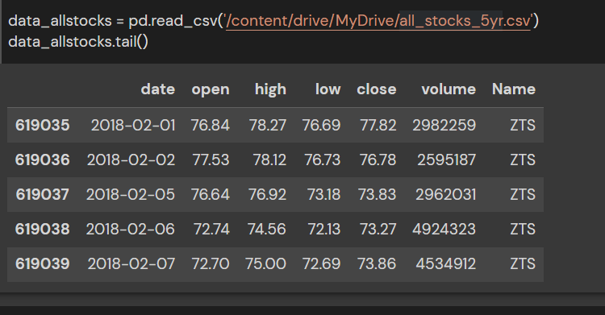
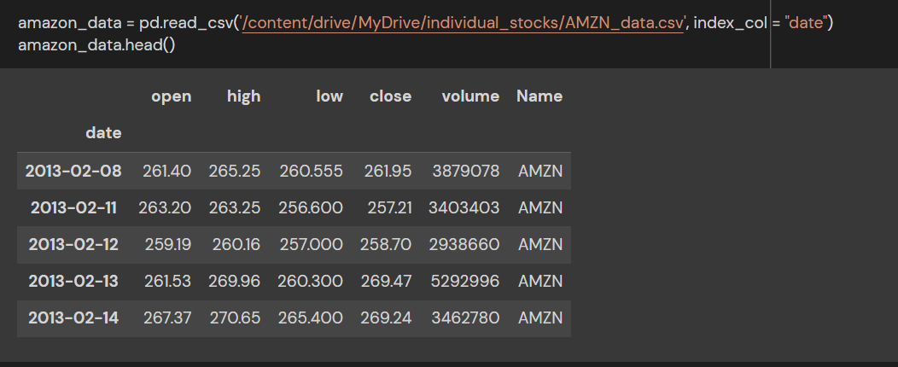
ALL STOCKS DATASET AND INDIVIDUAL STOCK DATASET

Slide 4
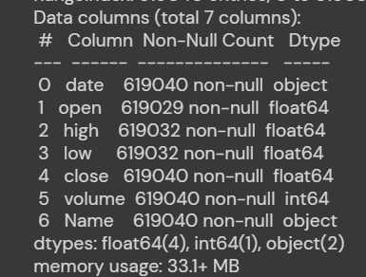
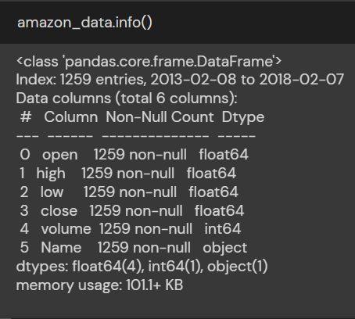
DATASET INFORMATION

Slide 5
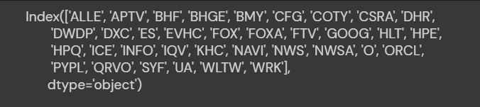

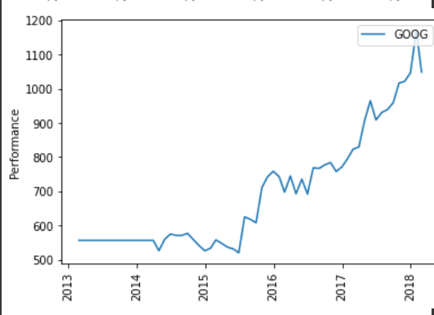
DATA PREPROCESSING
As we are about to clean the data for any discrepancies, we check for the NULL values (if any) and try to rectify it.
We remove the NULL values and replace it with a function named ‘bfill()’.
We then plot the graphs for each of the individual stocks.

Slide 6
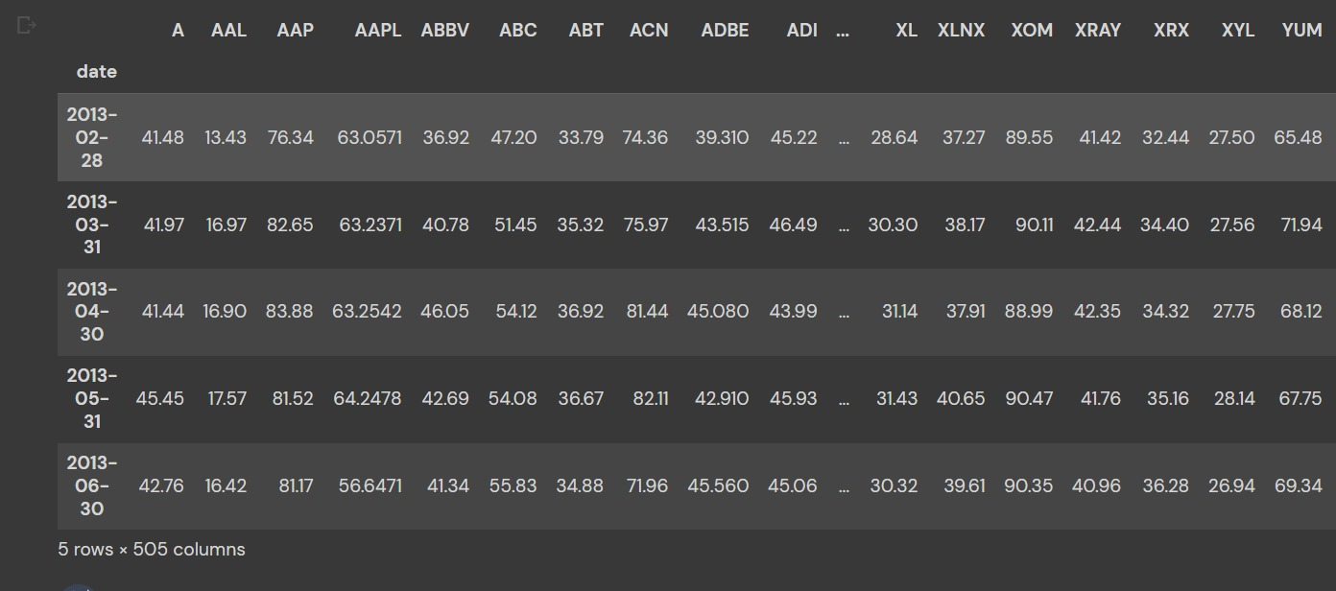
RESAMPLING & NORMALIZATION
The dataset contains stock details for a period of 5 years.
What we do is that we take only the End of the Month values for all the stocks so that we have the closing prices for that particular month.

Slide 7
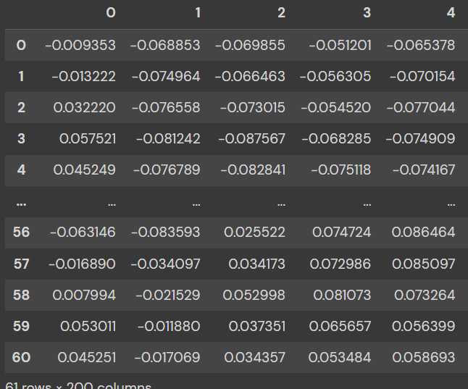
Contd..
Now the data is being scaled using StandardScaler() to bring the mean to 0 and scale each of the feature to UNIT variance.
The scaled values are then brought to UNIT norm using normalize().

Slide 8
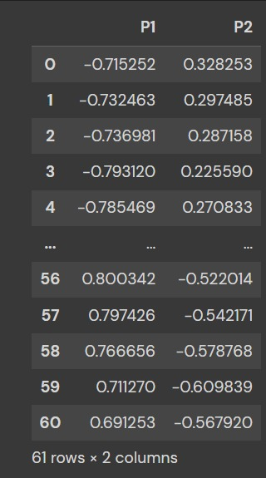
CLUSTERING
The main aim of this process is to cluster the given stock details based on the movement of prices over 5 years.
We use Agglomerative clustering for this and check for the clustering output.
PCA:
First, we reduce the number of components and
transform the normalized data.

Slide 9
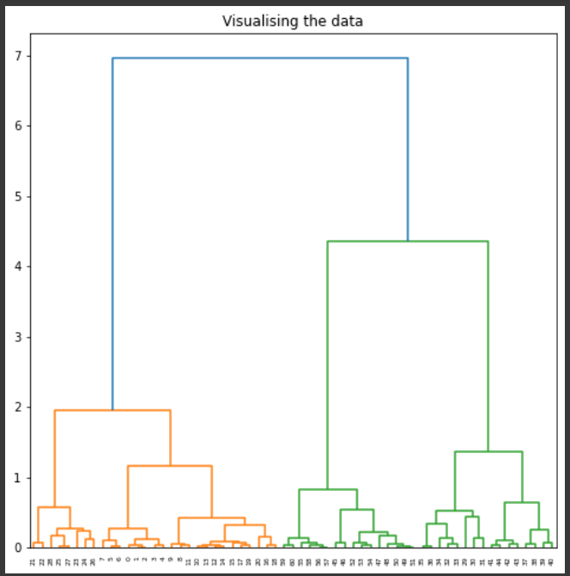
VISUALIZING THE PCA
Dendrogram is used here to show the hierarchical relationship between the stocks.
We can work out the best way to allocate the stocks to clusters.
The height of the dendrogram indicates the order in which the clusters are to be joined.

Slide 10
AGGLOMERATIVE CLUSTERING
After PCA, now we try to find the number of clusters using Hierarchial clustering technique.
The number of clusters were tried for values 2 to 7.
And the results,

Slide 11
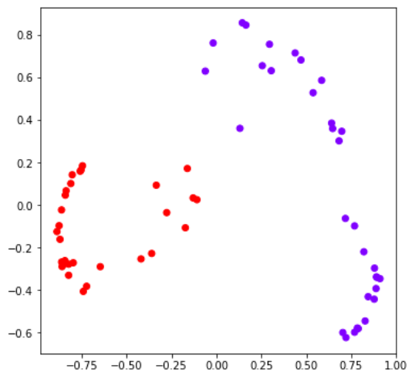
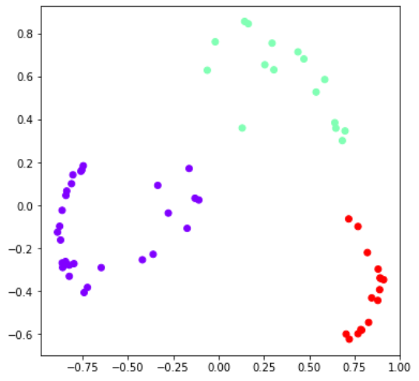
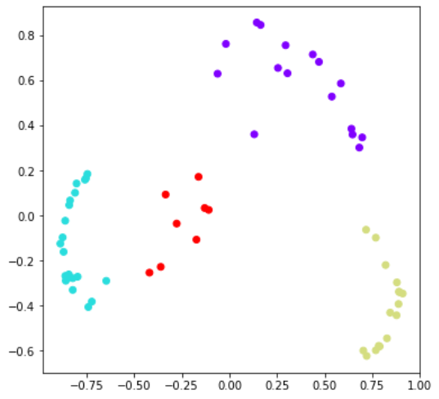
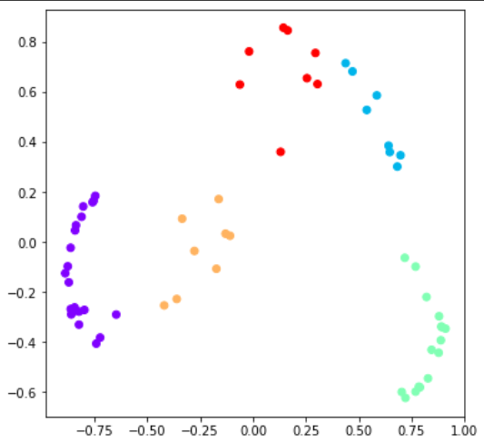
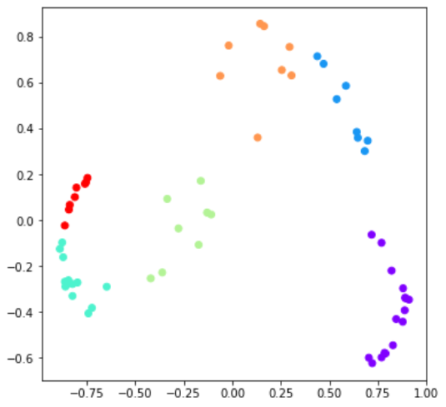
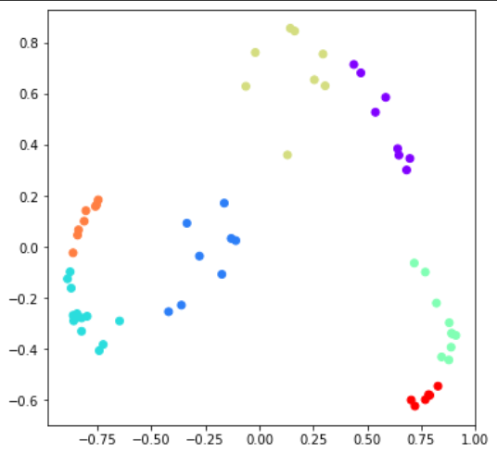
N = 2
N = 3
N = 4
N = 5
N = 6
N = 7

Slide 12
FINDING THE RIGHT CLUSTER SIZE
As of now, we have sorted clusters of upto 7.
Now we have to find out the right cluster size. This can be found out using the SILHOUETTE score.
This can be found out using plotting a graph with taking the values of PCA data in X-axis and the predicting the fitted value of PCA in Y-axis.

Slide 13
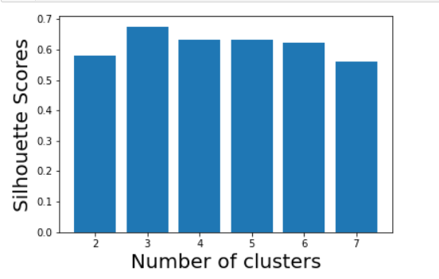
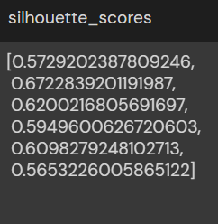
EVALUATION
Upon finding out the silhouette scores of the clusters, we find out that..
The score for the cluster size = 3 has the highest silhouette score which means the clusters are well apart from each other and distinguished.

Slide 14
CONCLUSION
We started with the S&P 500 dataset of individual stocks. The datset was cleaned from null values unsing ‘bfill’ method.
The data was resampled to take only the closing prices at the end of every month (i.e) one closing price for every month.
The data was scaled, normalized and the value was used to calculate the PCA.
Using the PCA, dendogram was formed and the silhouette scores were calculated.
Using the score, we found out that the number of clusters for the stocks clustering is 3 with a score of 0.6722

Slide 15
FURTHER PROJECT SCOPE
FUTURE STOCK PRICE PREDICTION USING TIME SERIES ANALYSIS LSTM method.
The scope of this piece of analysis is predicting the stock value price based on the past price movement of a particular stock (Daily or Monthly or Yearly).
The model being used here is LSTM – Long Short Term Memory Networks.
The model competes with Recurrent Neural Networks, ARIMA models in terms of accuracy and working with the size of the dataset.

Slide 16
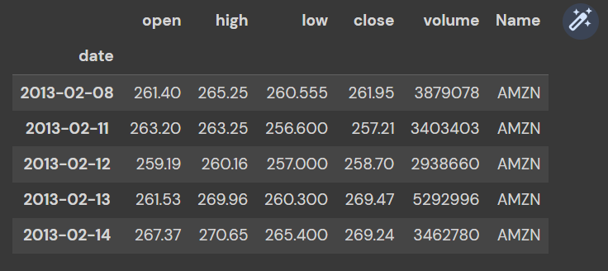
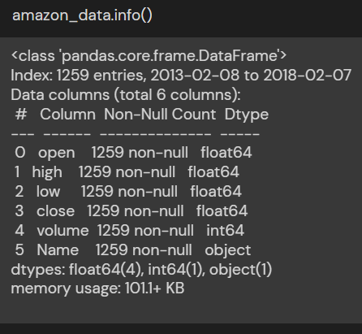
PROCESS..
We have taken a random stock for the price prediction (AMAZON stock price).
We then plot the opening and closing prices of AMAZON for the entire period.

Slide 17
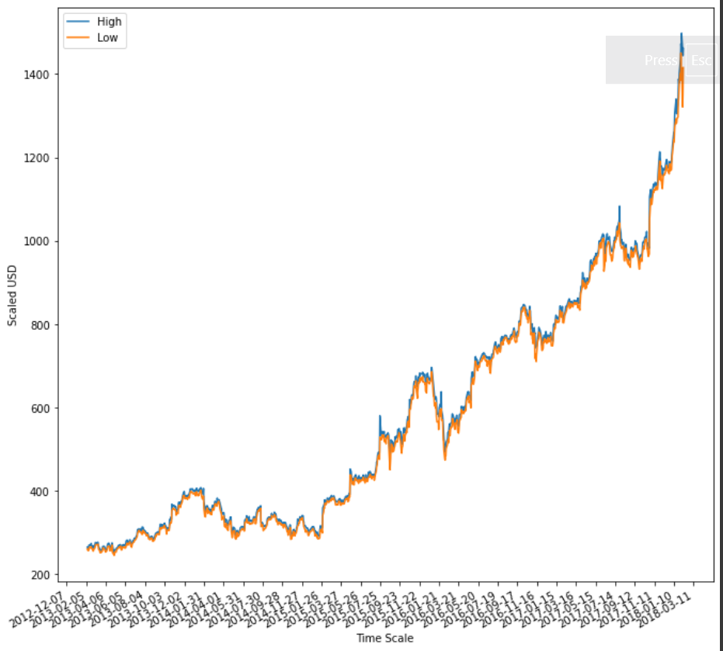

Slide 18
PROCESS CONTD..
The LSTM model is to be trained with the training set of AMAZON stock price data and find out the accuracy of the train data.
Using the modelled train set, we can find out the prediction value of the stock price in the future.
Advantages:
LSTM’s are a special kind of Recurrent Neural Networks that is capable of learning long-term dependencies.
LSTMs deal with vanishing and exploding gradient problem.

Slide 19
THANK YOU…

